Slide 1

Repeats and composition bias
Miguel Andrade
Faculty of Biology,
Johannes Gutenberg University
Institute of Molecular Biology
Mainz, Germany
andrade@uni-mainz.de

Slide 2
Repeats

Slide 3
Frequency
14% proteins contains repeats (Marcotte et al, 1999)
1: Single amino acid repeats.
2: Longer imperfect tandem repeats. Assemble in structure.

Slide 4
Definition repeats
Sequence, long, imperfect, tandem
MRAVVKSPIMCHEKSPSVCSPLNMTSSVCSPAGINSVSSTTASF
GSFPVHSPITQGTPLTCSPNVENRGSRSHSPAHASNVGSPLSSPLSSMKSSISSPPSHCSVKSPVSSPNNVTLRSSVSSPANINN

Slide 5
Definition repeats
Sequence, long, imperfect, tandem
MRAVVKSPIMCHEKSPSVCSPLNMTSSVCSPAGINSVSSTTASFGSFPVHSPITQGTPLTCSPNVENRGSRSHSPAHASNVGSPLSSPLSSMKSSISSPPSHCSVKSPVSSPNNVTLRSSVSSPANINN

Slide 6
Definition repeats
Sequence, long, imperfect, tandem
MRAVVKSPIM CHE
KSPSVCSPLN
MTSSVCSPAG INSVSSTTASF
GSFPVHSPIT Q
GTPLTCSPNV EN
RGSRSHSPAH ASN
VGSPLSSPLS S
MKSSISSPPS HCS
VKSPVSSPNN VT
LRSSVSSPAN INN

Slide 7
Definition repeats
Sequence, long, imperfect, tandem
MRAVVKSPIM CHE
KSPSVCSPLN
MTSSVCSPAG INSVSSTTASF
GSFPVHSPIT Q
GTPLTCSPNV EN
RGSRSHSPAH ASN
VGSPLSSPLS S
MKSSISSPPS HCS
VKSPVSSPNN VT
LRSSVSSPAN INN

Slide 8
Tandem repeats fold together

Slide 9
Tandem repeats fold together

Slide 10
Tandem repeats fold together

Slide 11
Tandem repeats fold together

Slide 12
Tandem repeats fold together

Slide 13
Tandem repeats fold together

Slide 14
Definition repeats
Sequence, long, imperfect, tandem
MRAVVKSPIM CHE
KSPSVCSPLN
MTSSVCSPAG INSVSSTTASF
GSFPVHSPIT Q
GTPLTCSPNV EN
RGSRSHSPAH ASN
VGSPLSSPLS S
MKSSISSPPS HCS
VKSPVSSPNN VT
LRSSVSSPAN INN

Slide 15
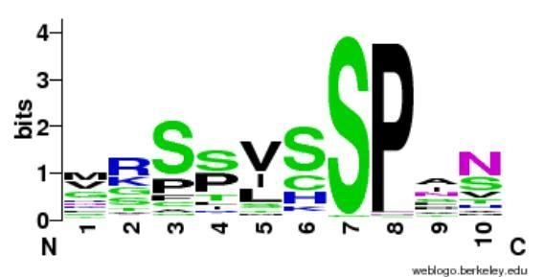
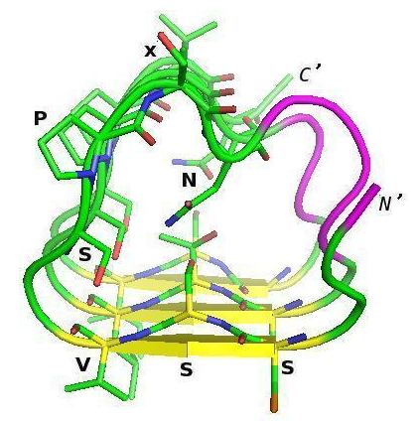
http://weblogo.berkeley.edu
(Vlassi et al, 2013)
Notes:
15

Slide 16
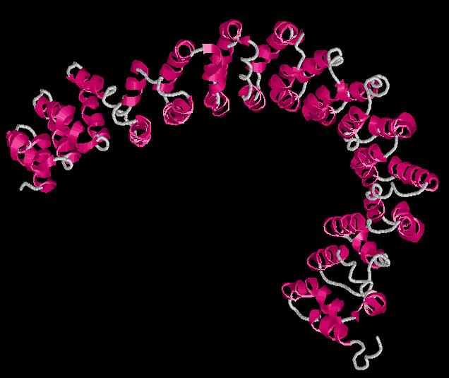
A subunit PP2A structure
PDB:1b3u
Groves et al. (1999) Cell

Slide 17
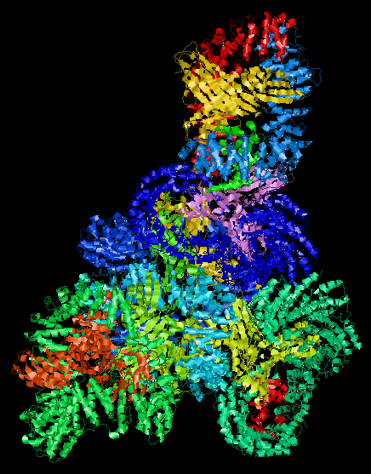
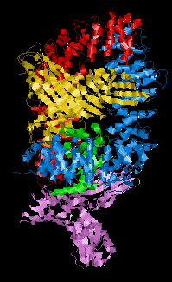
Ap1 Clathrin Adaptor Core
PDB:1w63
Heldwein et al. (2004) PNAS

Slide 18
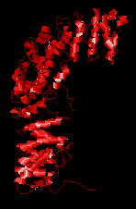

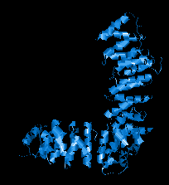
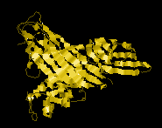
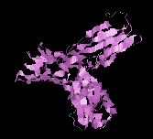
Ap1 Clathrin Adaptor Core
PDB:1w63
Heldwein et al. (2004) PNAS

Slide 19
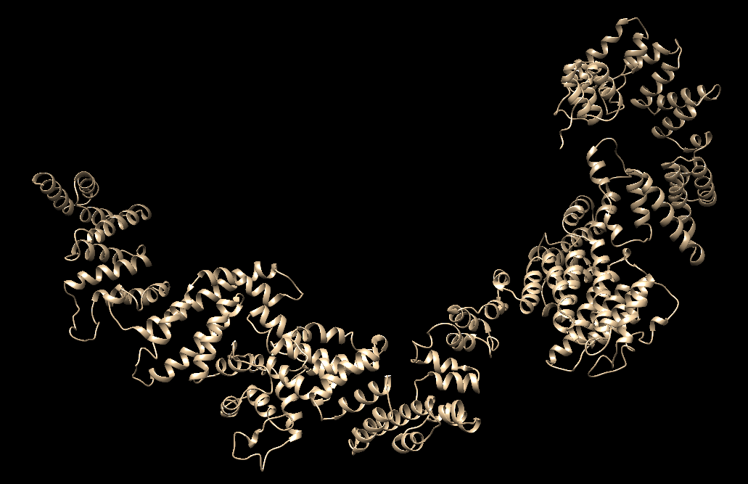
i-TASSER model of D. melanogaster thr protein
Based on PDB 4BUJ chain B

Slide 20
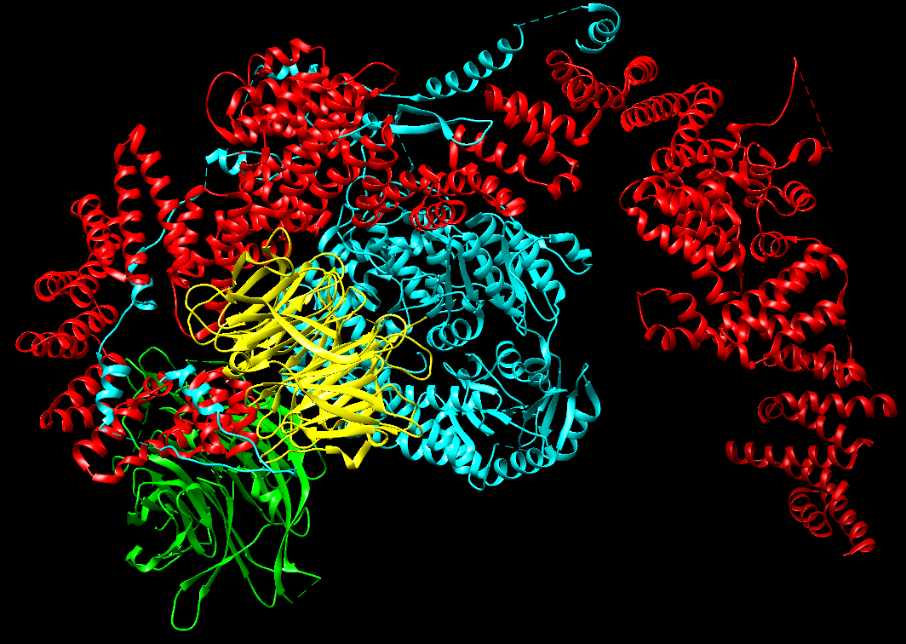
PDB 4BUJ
Ski complex (yeast)

Slide 21
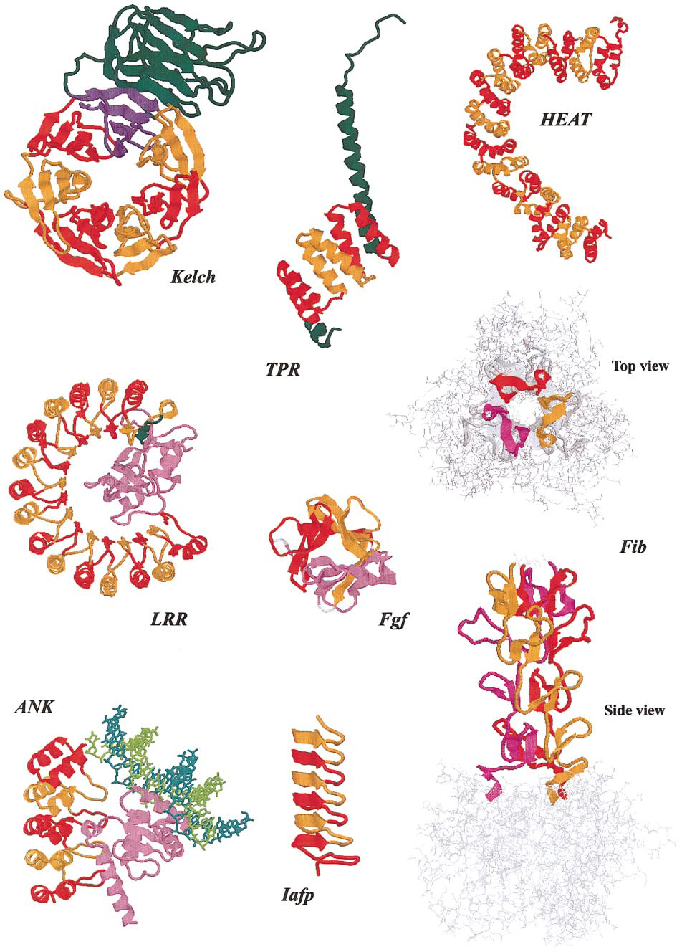
Andrade et al. (2001)
J Struct Biol

Slide 22
Frequency repeats
Fraction of proteins annotated with the keyword REPEAT in SwissProt
%
Archaea 27/3428 0.79
Viruses 81/8048 1.00
Bacteria 299/28438 1.05
Fungi 232/8334 2.78
Viridiplantae 153/6963 2.20
Metazoa 1538/28948 5.31
Rest of Eukaryota 92/2434 3.78
(Andrade et al 2001)

Slide 23
Definition CBRs
Perfect repeat: QQQQQQQQQQQ
Imperfect: QQQQPQQQQQQ
Amino acid type: DDDDDEEEDEDEED
Compositionally biased regions (CBRs)
High frequency of one or two amino acids in a region.
Particular case of low complexity region

Slide 24
Detection CBRs
Sometimes straightforward.
N-terminal human Huntingtin.
How many CBRs can you find?
>sp|P42858|HD_HUMAN Huntingtin OS=Homo sapiens MATLEKLMKAFESLKSFQQQQQQQQQQQQQQQQQQQQQPPPPPPPPPPPQLPQPPPQAQP LLPQPQPPPPPPPPPPGPAVAEEPLHRPKKELSATKKDRVNHCLTICENIVAQSVRNSPE FQKLLGIAMELFLLCSDDAESDVRMVADECLNKVIKALMDSNLPRLQLELYKEIKKNGAP RSLRAALWRFAELAHLVRPQKCRPYLVNLLPCLTRTSKRPEESVQETLAAAVPKIMASFG NFANDNEIKVLLKAFIANLKSSSPTIRRTAAGSAVSICQHSRRTQYFYSWLLNVLLGLLV PVEDEHSTLLILGVLLTLRYLVPLLQQQVKDTSLKGSFGVTRKEMEVSPSAEQLVQVYEL TLHHTQHQDHNVVTGALELLQQLFRTPPPELLQTLTAVGGIGQLTAAKEESGGRSRSGSI VELIAGGGSSCSPVLSRKQKGKVLLGEEEALEDDSESRSDVSSSALTASVKDEISGELAA SSGVSTPGSAGHDIITEQPRSQHTLQADSVDLASCDLTSSATDGDEEDILSHSSSQVSAV PSDPAMDLNDGTQASSPISDSSQTTTEGPDSAVTPSDSSEIVLDGTDNQYLGLQIGQPQD EDEEATGILPDEASEAFRNSSMALQQAHLLKNMSHCRQPSDSSVDKFVLRDEATEPGDQE NKPCRIKGDIGQSTDDDSAPLVHCVRLLSASFLLTGGKNVLVPDRDVRVSVKALALSCVG AAVALHPESFFSKLYKVPLDTTEYPEEQYVSDILNYIDHGDPQVRGATAILCGTLICSIL

Slide 25
Detection CBRs
Sometimes straightforward.
N-terminal human Huntingtin.
How many CBRs can you find?
>sp|P42858|HD_HUMAN Huntingtin OS=Homo sapiens MATLEKLMKAFESLKSFQQQQQQQQQQQQQQQQQQQQQPPPPPPPPPPPQLPQPPPQAQP LLPQPQPPPPPPPPPPGPAVAEEPLHRPKKELSATKKDRVNHCLTICENIVAQSVRNSPE FQKLLGIAMELFLLCSDDAESDVRMVADECLNKVIKALMDSNLPRLQLELYKEIKKNGAP RSLRAALWRFAELAHLVRPQKCRPYLVNLLPCLTRTSKRPEESVQETLAAAVPKIMASFG NFANDNEIKVLLKAFIANLKSSSPTIRRTAAGSAVSICQHSRRTQYFYSWLLNVLLGLLV PVEDEHSTLLILGVLLTLRYLVPLLQQQVKDTSLKGSFGVTRKEMEVSPSAEQLVQVYEL TLHHTQHQDHNVVTGALELLQQLFRTPPPELLQTLTAVGGIGQLTAAKEESGGRSRSGSI VELIAGGGSSCSPVLSRKQKGKVLLGEEEALEDDSESRSDVSSSALTASVKDEISGELAA SSGVSTPGSAGHDIITEQPRSQHTLQADSVDLASCDLTSSATDGDEEDILSHSSSQVSAV PSDPAMDLNDGTQASSPISDSSQTTTEGPDSAVTPSDSSEIVLDGTDNQYLGLQIGQPQD EDEEATGILPDEASEAFRNSSMALQQAHLLKNMSHCRQPSDSSVDKFVLRDEATEPGDQE NKPCRIKGDIGQSTDDDSAPLVHCVRLLSASFLLTGGKNVLVPDRDVRVSVKALALSCVG AAVALHPESFFSKLYKVPLDTTEYPEEQYVSDILNYIDHGDPQVRGATAILCGTLICSIL

Slide 26
Detection CBRs
Sometimes straightforward.
N-terminal human Huntingtin.
How many CBRs can you find?
>sp|P42858|HD_HUMAN Huntingtin OS=Homo sapiens MATLEKLMKAFESLKSFQQQQQQQQQQQQQQQQQQQQQPPPPPPPPPPPQLPQPPPQAQP LLPQPQPPPPPPPPPPGPAVAEEPLHRPKKELSATKKDRVNHCLTICENIVAQSVRNSPE FQKLLGIAMELFLLCSDDAESDVRMVADECLNKVIKALMDSNLPRLQLELYKEIKKNGAP RSLRAALWRFAELAHLVRPQKCRPYLVNLLPCLTRTSKRPEESVQETLAAAVPKIMASFG NFANDNEIKVLLKAFIANLKSSSPTIRRTAAGSAVSICQHSRRTQYFYSWLLNVLLGLLV PVEDEHSTLLILGVLLTLRYLVPLLQQQVKDTSLKGSFGVTRKEMEVSPSAEQLVQVYEL TLHHTQHQDHNVVTGALELLQQLFRTPPPELLQTLTAVGGIGQLTAAKEESGGRSRSGSI VELIAGGGSSCSPVLSRKQKGKVLLGEEEALEDDSESRSDVSSSALTASVKDEISGELAA SSGVSTPGSAGHDIITEQPRSQHTLQADSVDLASCDLTSSATDGDEEDILSHSSSQVSAV PSDPAMDLNDGTQASSPISDSSQTTTEGPDSAVTPSDSSEIVLDGTDNQYLGLQIGQPQD EDEEATGILPDEASEAFRNSSMALQQAHLLKNMSHCRQPSDSSVDKFVLRDEATEPGDQE NKPCRIKGDIGQSTDDDSAPLVHCVRLLSASFLLTGGKNVLVPDRDVRVSVKALALSCVG AAVALHPESFFSKLYKVPLDTTEYPEEQYVSDILNYIDHGDPQVRGATAILCGTLICSIL

Slide 27
Detection CBRs
Sometimes straightforward.
N-terminal human Huntingtin.
How many CBRs can you find?
>sp|P42858|HD_HUMAN Huntingtin OS=Homo sapiens MATLEKLMKAFESLKSFQQQQQQQQQQQQQQQQQQQQQPPPPPPPPPPPQLPQPPPQAQP LLPQPQPPPPPPPPPPGPAVAEEPLHRPKKELSATKKDRVNHCLTICENIVAQSVRNSPE FQKLLGIAMELFLLCSDDAESDVRMVADECLNKVIKALMDSNLPRLQLELYKEIKKNGAP RSLRAALWRFAELAHLVRPQKCRPYLVNLLPCLTRTSKRPEESVQETLAAAVPKIMASFG NFANDNEIKVLLKAFIANLKSSSPTIRRTAAGSAVSICQHSRRTQYFYSWLLNVLLGLLV PVEDEHSTLLILGVLLTLRYLVPLLQQQVKDTSLKGSFGVTRKEMEVSPSAEQLVQVYEL TLHHTQHQDHNVVTGALELLQQLFRTPPPELLQTLTAVGGIGQLTAAKEESGGRSRSGSI VELIAGGGSSCSPVLSRKQKGKVLLGEEEALEDDSESRSDVSSSALTASVKDEISGELAA SSGVSTPGSAGHDIITEQPRSQHTLQADSVDLASCDLTSSATDGDEEDILSHSSSQVSAV PSDPAMDLNDGTQASSPISDSSQTTTEGPDSAVTPSDSSEIVLDGTDNQYLGLQIGQPQD EDEEATGILPDEASEAFRNSSMALQQAHLLKNMSHCRQPSDSSVDKFVLRDEATEPGDQE NKPCRIKGDIGQSTDDDSAPLVHCVRLLSASFLLTGGKNVLVPDRDVRVSVKALALSCVG AAVALHPESFFSKLYKVPLDTTEYPEEQYVSDILNYIDHGDPQVRGATAILCGTLICSIL

Slide 28
Detection repeats
Sometimes straightforward.
N-terminal human Huntingtin.
How many repeats can you find?
>sp|P42858|HD_HUMAN Huntingtin OS=Homo sapiens MATLEKLMKAFESLKSFQQQQQQQQQQQQQQQQQQQQQPPPPPPPPPPPQLPQPPPQAQP LLPQPQPPPPPPPPPPGPAVAEEPLHRPKKELSATKKDRVNHCLTICENIVAQSVRNSPE FQKLLGIAMELFLLCSDDAESDVRMVADECLNKVIKALMDSNLPRLQLELYKEIKKNGAP RSLRAALWRFAELAHLVRPQKCRPYLVNLLPCLTRTSKRPEESVQETLAAAVPKIMASFG NFANDNEIKVLLKAFIANLKSSSPTIRRTAAGSAVSICQHSRRTQYFYSWLLNVLLGLLV PVEDEHSTLLILGVLLTLRYLVPLLQQQVKDTSLKGSFGVTRKEMEVSPSAEQLVQVYEL TLHHTQHQDHNVVTGALELLQQLFRTPPPELLQTLTAVGGIGQLTAAKEESGGRSRSGSI VELIAGGGSSCSPVLSRKQKGKVLLGEEEALEDDSESRSDVSSSALTASVKDEISGELAA SSGVSTPGSAGHDIITEQPRSQHTLQADSVDLASCDLTSSATDGDEEDILSHSSSQVSAV PSDPAMDLNDGTQASSPISDSSQTTTEGPDSAVTPSDSSEIVLDGTDNQYLGLQIGQPQD EDEEATGILPDEASEAFRNSSMALQQAHLLKNMSHCRQPSDSSVDKFVLRDEATEPGDQE NKPCRIKGDIGQSTDDDSAPLVHCVRLLSASFLLTGGKNVLVPDRDVRVSVKALALSCVG AAVALHPESFFSKLYKVPLDTTEYPEEQYVSDILNYIDHGDPQVRGATAILCGTLICSIL

Slide 29
Detection repeats
Often NOT straightforward.
N-terminal human Huntingtin.
How many repeats can you find?
>sp|P42858|HD_HUMAN Huntingtin OS=Homo sapiens MATLEKLMKAFESLKSFQQQQQQQQQQQQQQQQQQQQQPPPPPPPPPPPQLPQPPPQAQP LLPQPQPPPPPPPPPPGPAVAEEPLHRPKKELSATKKDRVNHCLTICENIVAQSVRNSPE FQKLLGIAMELFLLCSDDAESDVRMVADECLNKVIKALMDSNLPRLQLELYKEIKKNGAP RSLRAALWRFAELAHLVRPQKCRPYLVNLLPCLTRTSKRPEESVQETLAAAVPKIMASFG NFANDNEIKVLLKAFIANLKSSSPTIRRTAAGSAVSICQHSRRTQYFYSWLLNVLLGLLV PVEDEHSTLLILGVLLTLRYLVPLLQQQVKDTSLKGSFGVTRKEMEVSPSAEQLVQVYEL TLHHTQHQDHNVVTGALELLQQLFRTPPPELLQTLTAVGGIGQLTAAKEESGGRSRSGSI VELIAGGGSSCSPVLSRKQKGKVLLGEEEALEDDSESRSDVSSSALTASVKDEISGELAA SSGVSTPGSAGHDIITEQPRSQHTLQADSVDLASCDLTSSATDGDEEDILSHSSSQVSAV PSDPAMDLNDGTQASSPISDSSQTTTEGPDSAVTPSDSSEIVLDGTDNQYLGLQIGQPQD EDEEATGILPDEASEAFRNSSMALQQAHLLKNMSHCRQPSDSSVDKFVLRDEATEPGDQE NKPCRIKGDIGQSTDDDSAPLVHCVRLLSASFLLTGGKNVLVPDRDVRVSVKALALSCVG AAVALHPESFFSKLYKVPLDTTEYPEEQYVSDILNYIDHGDPQVRGATAILCGTLICSIL

Slide 30
Detection repeats
Often NOT straightforward.
N-terminal human Huntingtin.
How many repeats can you find?
EFQKLLGIAMELFLLCSDDAESDVRMVADECLNKVIKA
CRPYLVNLLPCLTRTSKRP-EESVQETLAAAVPKIMAS NDNEIKVLLKAFIANLKSSSPTIRRTAAGSAVSICQHS
TQYFYSWLLNVLLGLLVPVEDEHSTLLILGVLLTLRYL
PSAEQLVQVYELTLHHTQHQDHNVVTGALELLQQLFRT

Slide 31
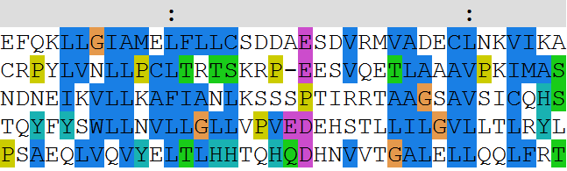
Detection repeats
Often NOT straightforward.
N-terminal human Huntingtin.
How many repeats can you find?
EFQKLLGIAMELFLLCSDDAESDVRMVADECLNKVIKA
CRPYLVNLLPCLTRTSKRP-EESVQETLAAAVPKIMAS NDNEIKVLLKAFIANLKSSSPTIRRTAAGSAVSICQHS
TQYFYSWLLNVLLGLLVPVEDEHSTLLILGVLLTLRYL
PSAEQLVQVYELTLHHTQHQDHNVVTGALELLQQLFRT

Slide 32
Detection of repeats
Dotplots
Comparing a sequence against itself

Slide 33
Detection of repeats
Dotplots
TLRSSVSSPANINNS
NMTSSVCSPANISV

Slide 34
Detection of repeats
Dotplots
TLRSSVSSPANINNS
|
1 match
NMTSSVCSPANISV

Slide 35
Detection of repeats
Dotplots
TLRSSVSSPANINNS
||| |||||
8 matches
NMTSSVCSPANISV

Slide 36
Detection of repeats
Dotplots
TLRSSVSSPANINNS
| |
2 matches
NMTSSVCSPANISV

Slide 37
Detection of repeats
Dotplots
TLRSSVSSPANINNS
|
1 match
NMTSSVCSPANISV

Slide 38
Detection of repeats
Dotplots
TLRSSVSSPANINNS
NMTSSVCSPANISV
8

Slide 39
Detection of repeats
Dotplots
TLRSSVSSPANINNS
NMTSSVCSPANISV
1821

Slide 40
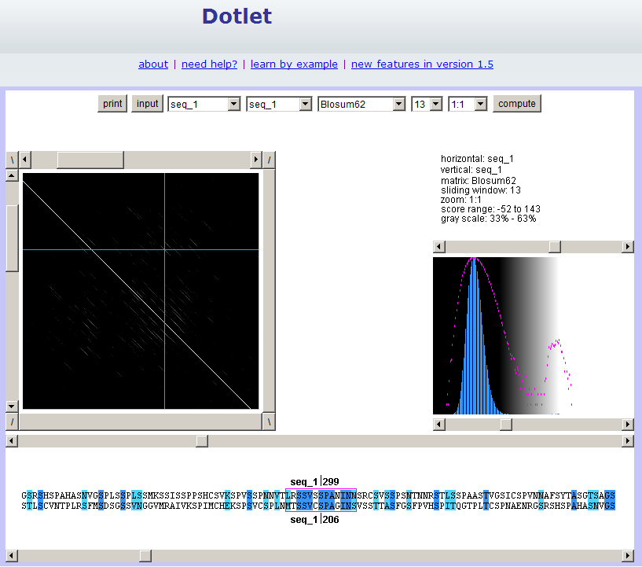
Exercise 1

Slide 41
Exercise 1/4. Using Dotlet with the human mineralocorticoid receptor (MR)
Go to the Dotlet web page:
http://myhits.isb-sib.ch/cgi-bin/dotlet
Click on the input button and paste the sequence of the human mineralocorticoid receptor (UniProt id P08235)
Click on the “compute” button
Try to find combinations of parameters that show patterns in the dot plot (Hint: You can adjust this finely using the arrows)
Find repetitions clicking in the diagonal patterns

Slide 42
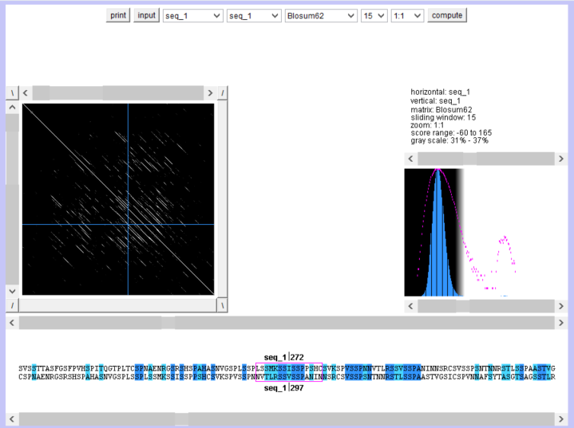
Exercise 1/4. Using Dotlet with the human mineralocorticoid receptor (MR)

Slide 43
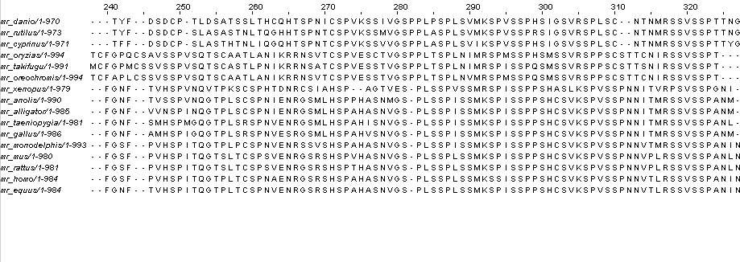
Detection of repeats
Using a multiple sequence alignment helps.
Conserved repeated patterns
JalView with Regular Expression searches

Slide 44
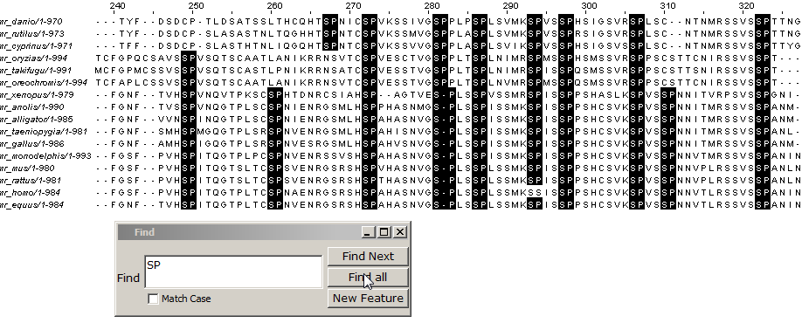
Detection of repeats
Using a multiple sequence alignment helps
Conserved repeated patterns
JalView with Regular Expression searches

Slide 45
Detection of repeats
Using a multiple sequence alignment helps
Conserved repeated patterns
JalView with Regular Expression searches

Slide 46
Detection of repeats
Using a multiple sequence alignment helps
Conserved repeated patterns
JalView with Regular Expression searches
Regular Expressions:
[LS]P.A
matches L or S, followed by P, followed by anything, followed by A

Slide 47
Detection of repeats
Using a multiple sequence alignment helps
Conserved repeated patterns
JalView with Regular Expression searches
Regular Expressions:
[LS]P.A
matches L or S, followed by P, followed by anything, followed by A
Which one is not matched?
LPTA, SPAA, LPPA, LPAP, SPLA

Slide 48
Detection of repeats
Using a multiple sequence alignment helps
Conserved repeated patterns
JalView with Regular Expression searches
Regular Expressions:
[LS]P.A
matches L or S, followed by P, followed by anything, followed by A
Which one is not matched?
LPTA, SPAA, LPPA, LPAP, SPLA

Slide 49
Exercise 2/4. Using JalView with a MSA of the MR with orthologs
Load the multiple sequence alignment of the MR in JalView: MR1_fasta.txt
Use the “Select > find" (of Ctrl+F) option with a regular expression and mark all matches (click the “Find all” option!)
Try to find the expression that matches more repeats. How many repeats do you see? How long are they? Would you correct the alignment based on these findings?

Slide 50
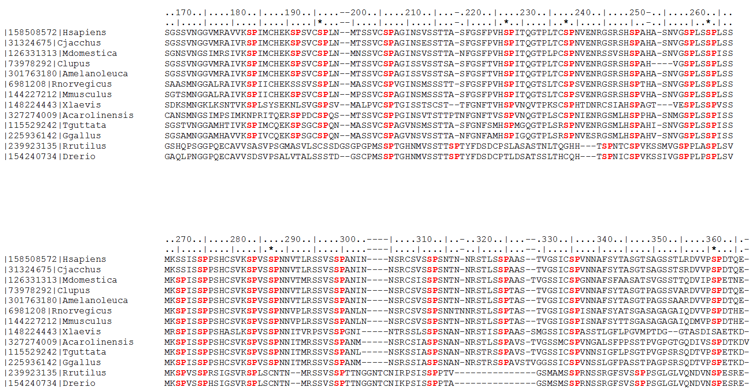
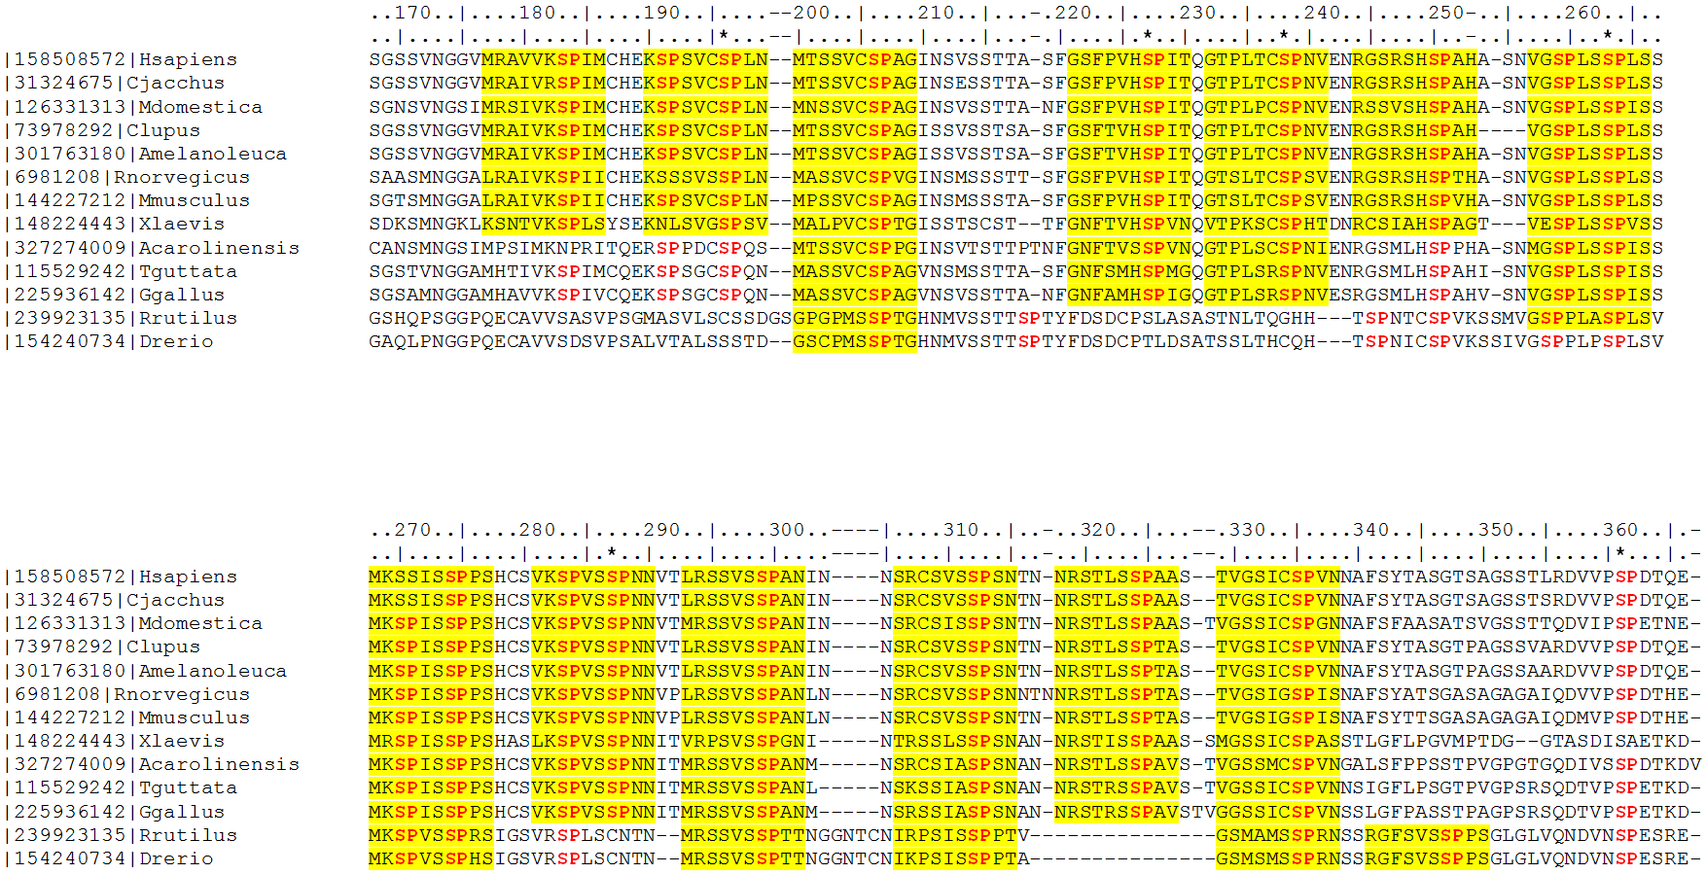
#T1
#T2
#T3
#T4
#T5
#T6
#T7
*
*
*
*
#F1
#F2
#F3
#F4
#T8
#T9
#T10
#T11
#T12
#T13
#T14
#T15
*
*
*
#F5
#F6
#F7
#F8
#F9
#F10
#F11
Vlassi et al. (2013) BMC Struct. Biol.
Notes:
50

Slide 51
Mineralocorticoid receptor
Repeat region
AF1a
ID
AF1b
DBD
LBD
984 aa
NTD
0
100
200
300
400
500
600
700
800
900
1000
aa
Vlassi et al. (2013) BMC Struct. Biol.
Notes:
51

Slide 52
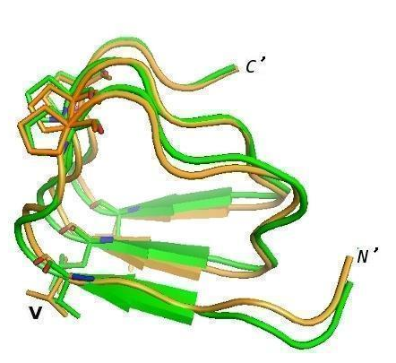
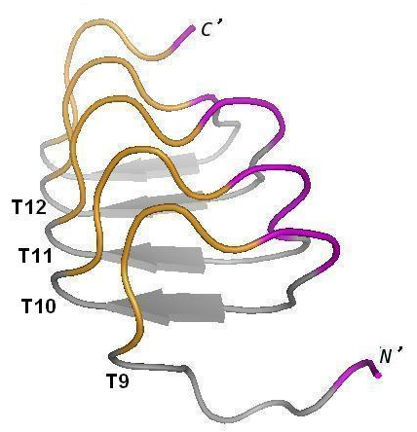
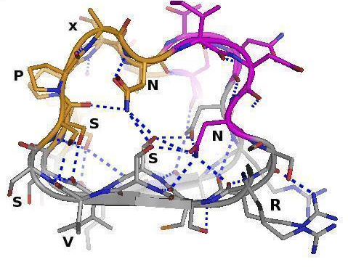
Notes:
52
52

Slide 53
Composition bias

Slide 54
Definition
14% proteins contains repeats (Marcotte et al, 1999)
1: Single amino acid repeats.
2: Longer imperfect tandem repeats. Assemble in structure.

Slide 55
Definition CBRs
Perfect repeat: QQQQQQQQQQQ
Imperfect: QQQQPQQQQQQ
Amino acid type: DDDDDEEEDEDEED
Compositionally biased regions (CBRs)
High frequency of one or two amino acids in a region.
Particular case of low complexity region

Slide 56
Function CBRs
Conservation => Function
Length, amino acid type not necessarily conserved
Frequency: 1 in 3 proteins contains a compositionally biased region (Wootton, 1994), ~11% conserved (Sim and Creamer, 2004)

Slide 57
Function CBRs
Conservation => Function
Length, amino acid type not necessarily conserved
Functions:
Passive: linkers
Active: binding, mediate protein interaction, structural integrity
(Sim and Creamer, 2004)

Slide 58
Structure of CBRs
Often variable or flexible: do not easily crystalize

Slide 59
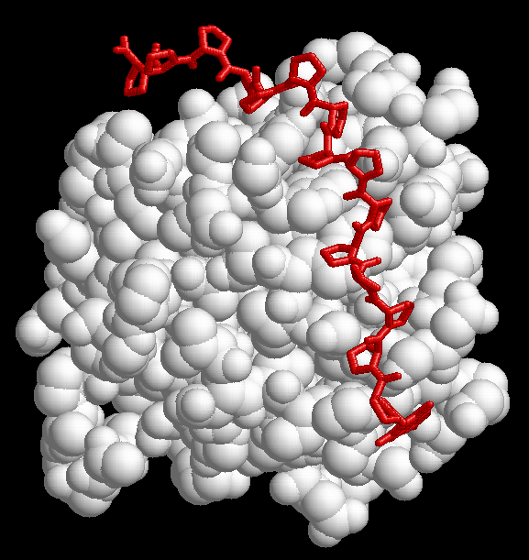
1CJF: profilin bound to polyP

Slide 60
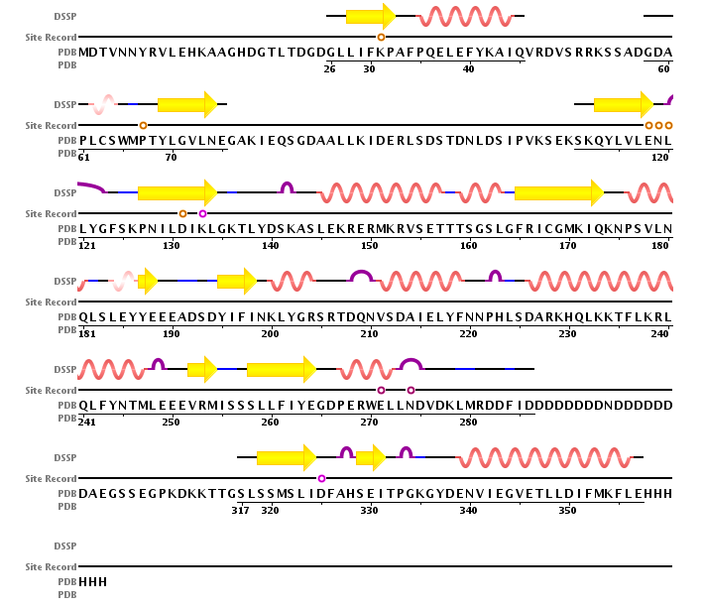
2IF8: Inositol Phosphate Multikinase Ipk2

Slide 61
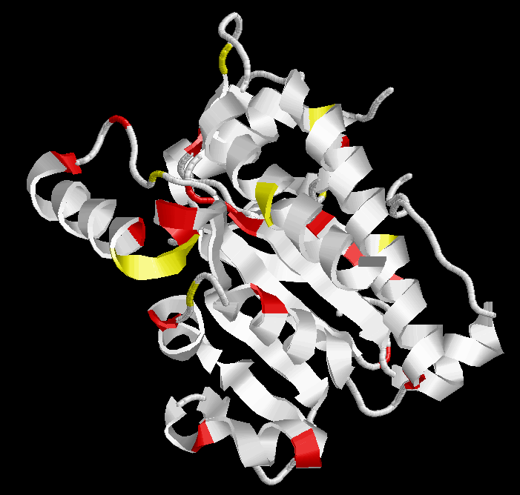
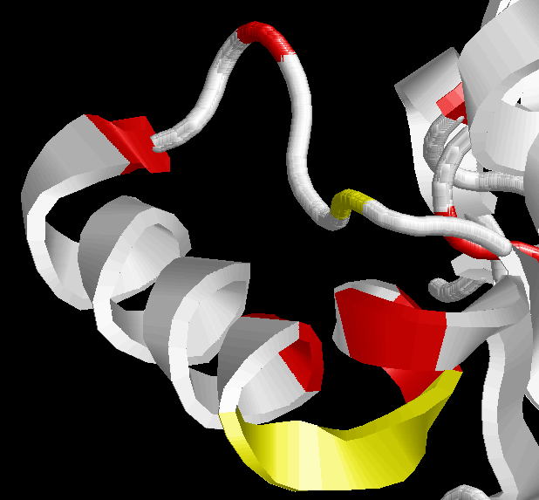
2IF8: Inositol Phosphate Multikinase Ipk2
RVSETTTSGSL

Slide 62
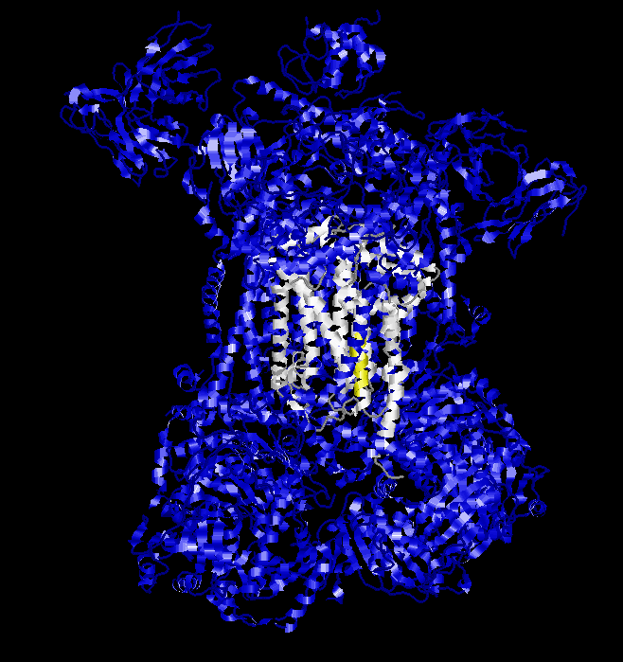
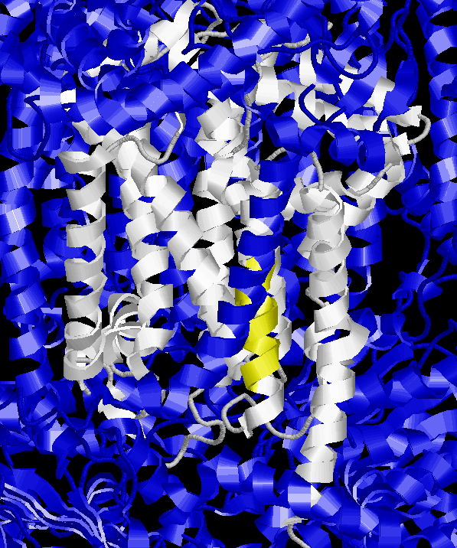
2CX5: mitochondrial cytochrome c
B subunit N-terminal

Slide 63
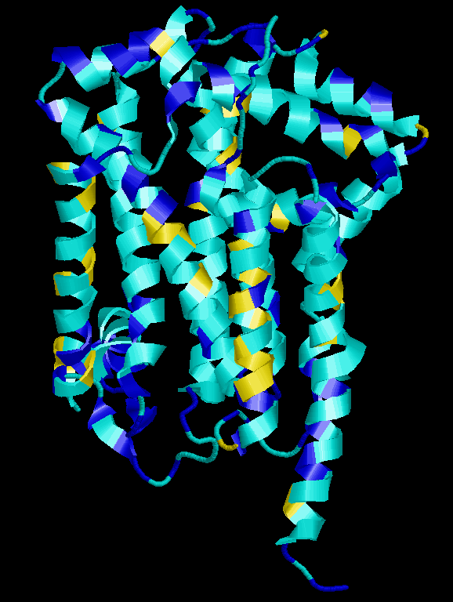

2CX5: mitochondrial cytochrome c
B subunit N-terminal
FFFFIFVFNF

Slide 64
Amino acid repeats
Distribution is not random:
Eukaryota:
Most common: poly-Q, poly-N, poly-A, poly-S, poly-G
Prokaryota:
Most common: poly-S, poly-G, poly-A, poly-P
Relatively rare: poly-Q, poly-N
Very rare or absent in both eukaryota and prokaryota:
Poly-I, Poly-M, Poly-W, Poly-C, Poly-Y
Toxicity of long stretches of hydrophobic residues.
(Faux et al 2005)

Slide 65
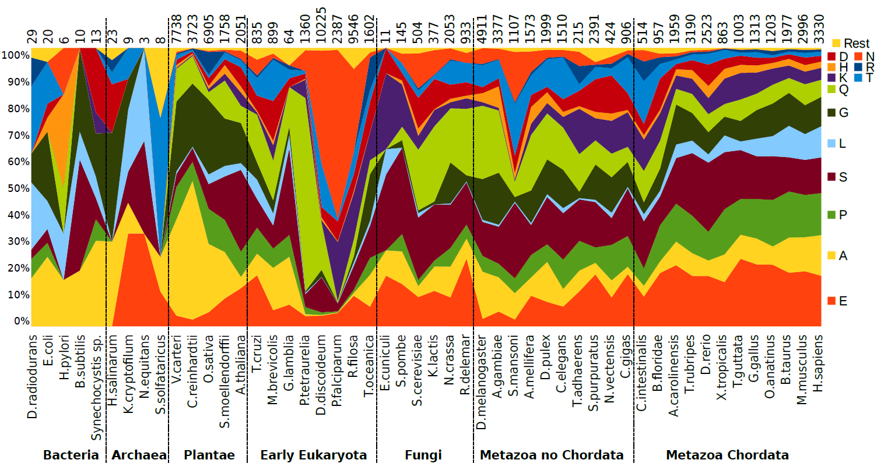

Amino acid repeats
Pablo Mier

Slide 66
Filtering out CBRs
Normally filtered out as low complexity region: they give spurious BLAST hits
QQQQQQQQQQ
||||||||||
QQQQQQQQQQ 10/10 id
IDENTITIES
||||||||||
IDENTITIES 10/10 id

Slide 67
Filtering out CBRs
Normally filtered out as low complexity region: they give spurious BLAST hits
QQQQQQQQQQ
||||||||||
QQQQQQQQQQ Shuffle: 10/10 id
IDENTITIES
||||||||||
IDENTITIES 10/10 id

Slide 68
Filtering out CBRs
Normally filtered out as low complexity region: they give spurious BLAST hits
QQQQQQQQQQ
||||||||||
QQQQQQQQQQ Shuffle: 10/10 id
IDENTITIES
| |
SIINDIETTE Shuffle: 2/10 id

Slide 69
Filtering out CBRs
Option for pre-BLAST treatment
SEG algorithm:
1) Identify sequence regions with low information content over a sequence window
2) Merge neighbouring regions
Eliminates hits against common acidic-, basic- or proline-rich regions
(Wootton and Federhen, 1993)

Slide 70
A particular analysis…
AIR9
(1708 aa)
Ser rich
+ basic
conserved
region
LRR
A9 repeats
Δ1
Δ3
Δ2
Δ15
Δ9
Δ10
Δ6
Δ11
Δ12
Buschmann, et al (2006).
Current Biology.
Buschmann, et al (2007).
Plant Signaling & Behavior
Δ14
Δ16
Microtubule localization of Δx-GFP

Slide 71
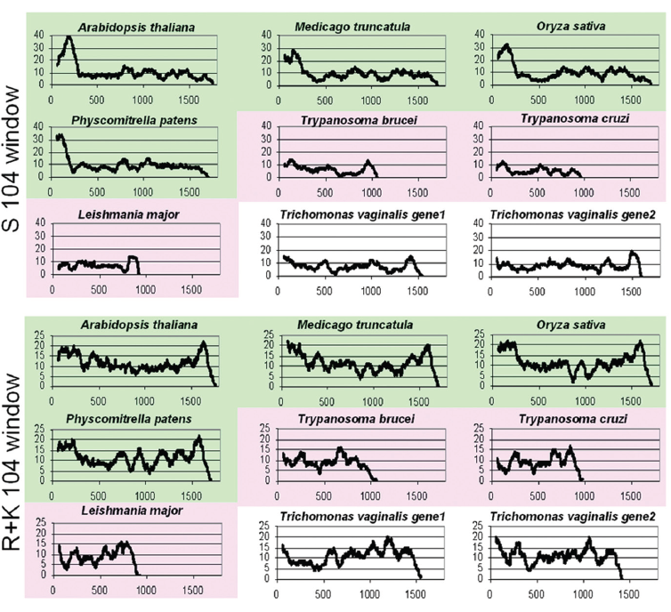
A particular analysis…
…triggers a tool

Slide 72

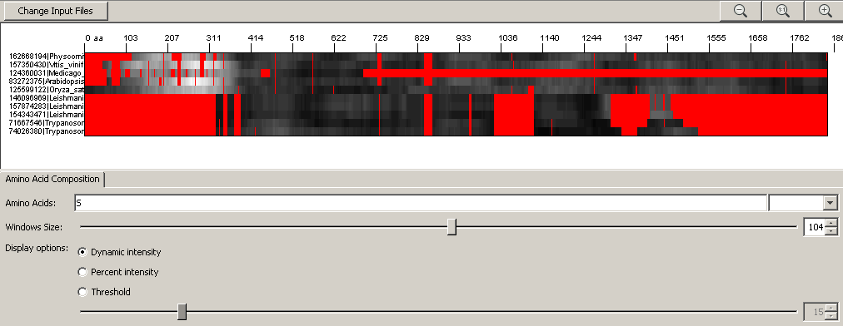
A particular analysis…
…triggers BiasViz
http://matthuska.github.io/biasviz/
Huska, et al. (2007). Bioinformatics

Slide 73
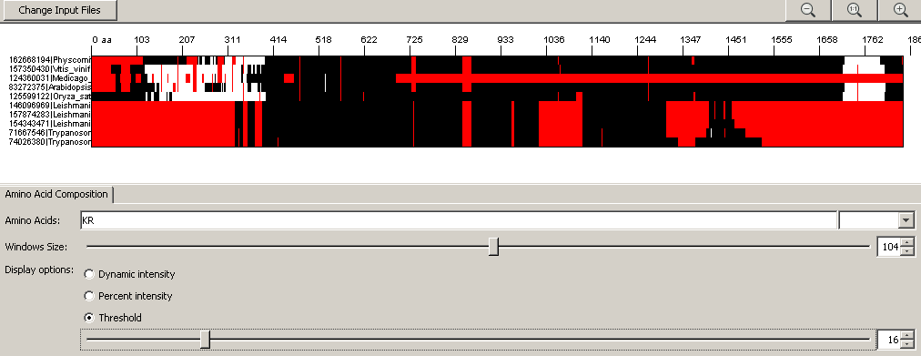
A particular analysis…
…triggers BiasViz
http://matthuska.github.io/biasviz/
Huska, et al. (2007). Bioinformatics

Slide 74
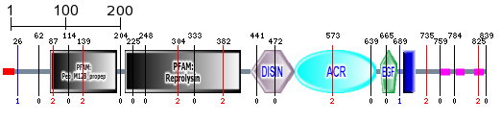
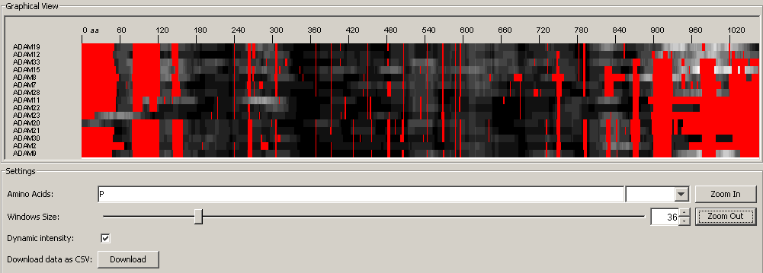
ADAM15
http://matthuska.github.io/biasviz/
Huska, et al. (2007). Bioinformatics

Slide 75
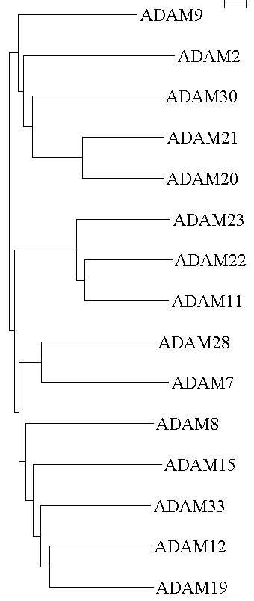
Binds SH3 of endophilin and SH3 PX1 PMID:10531379
Binds SH3 of endophilinI and SH3 PX1 PMID:10531379
Binds SH3 of Fish PMID:12615925
Binds SH3 of Grb2 PMID:11127814
Binds SH3 of Fish PMID:12615925
Binds SH3 of Fish PMID:12615925
Binds SH3 of ArgBP1/ABI2 PMID:12463424

Slide 76
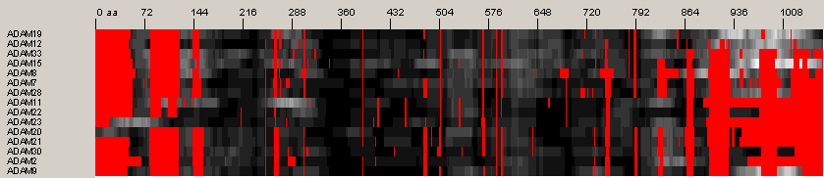
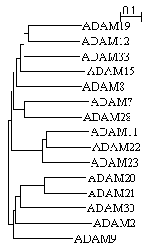
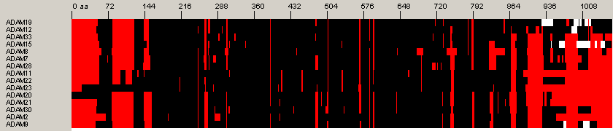
a
b
0.4
ADAM19
0.4
ADAM11
0.3
0.3
0.2
0.2
0.1
0.1
0.0
0.0
0.4
ADAM9
0.4
ADAM20
0.3
0.3
0.2
0.2
0.1
0.1
0.0
0.0
c

Slide 77
Allowing BiasViz2 to run
Type JavaRE8 Settings on start screen and run javaRE8 Settings v
(NOT: JavaRE Settings!)
Go to Security
Add an exception by clicking for
http://matthuska.github.io/
Run “Firefox with JRE”

Slide 78
Exercise 3/4. Viewing CBRs in an alignment with BiasViz2
Go to the BiasViz2 web page: http://matthuska.github.io/biasviz/
Launch BiasViz2
Load the alignment little_MSA_aln.txt on the step 1 section
Hit the "Go to graphical view" button
Try to find combinations of parameters that reveal CBRs
Try hydrophobic residues and window size 10. Remember that this is a transmembrane protein.
What is this result telling you?
Can you see other biased regions?

Slide 79
Exercise 4/4. Viewing CBRs in an alignment with BiasViz2
Launch BiasViz2
Load the alignment MR1_fasta.txt on the step 1 section
Try to detect the region with repeats as a compositionally biased region using a selection of two amino acids over-represented in the repeats.
Use display option “Threshold”
What is the optimal window size and threshold value to represent the region with repeats?

